Slide 1
Control of Gene Expression

Slide 2
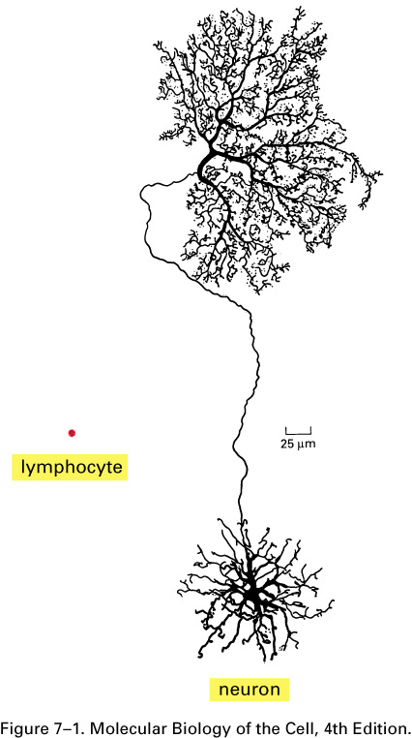
Different cell types of a multi-cellular organism contain the same DNA
A mammalian neuron and a lymphocyte.
The long branches of this neuron from the retina enable it to receive electrical signals from many cells and carry those signals to many neighboring cells. The lymphocyte is a white blood cell involved in the immune response to infection and moves freely through the body. Both of these cells contain the same genome, but they express different RNAs and proteins.

Slide 3
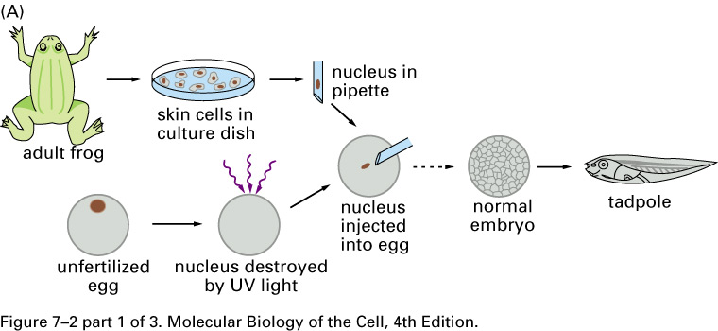
Evidence that a differentiated cell contains all the genetic instructions necessary to direct the formation of a complete organism.
(A) The nucleus of a skin cell from an adult frog transplanted into an enucleated egg can give rise to an entire tadpole. The broken arrow indicates that, to give the transplanted genome time to adjust to an embryonic environment, a further transfer step is required in which one of the nuclei is taken from the early embryo that begins to develop and is put back into a second enucleated egg.

Slide 4
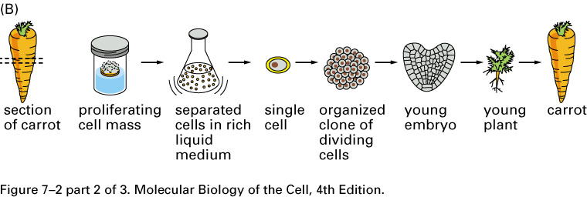
(B) In many types of plants, differentiated cells retain the ability to “dedifferentiate,” so that a single cell can form a clone of progeny cells that later give rise to an entire plant.

Slide 5
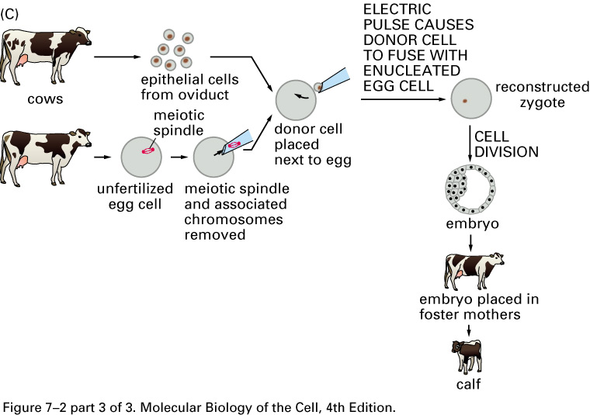
(C) A differentiated cell from an adult cow introduced into an enucleated egg from a different cow can give rise to a calf. Different calves produced from the same differentiated cell donor are genetically identical and are therefore clones of one another.

Slide 6
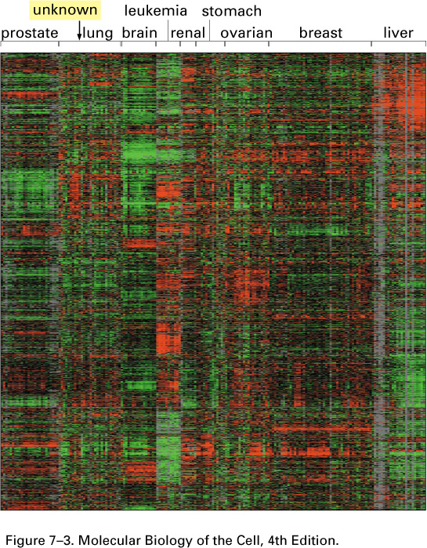
Different cell types synthesize different sets of proteins
Differences in mRNA expression patterns among different types of human cancer cells.
This figure summarizes a very large set of measurements in which the mRNA levels of 1800 selected genes (arranged top to bottom) were determined for 142 different human tumors (arranged left to right), each from a different patient. Each small red bar indicates that the given gene in the given tumor is transcribed at a level significantly higher than the average across all the cell lines. Each small green bar indicates a less-than-average expression level, and each black bar denotes an expression level that is close to average across the different tumors.

Slide 7
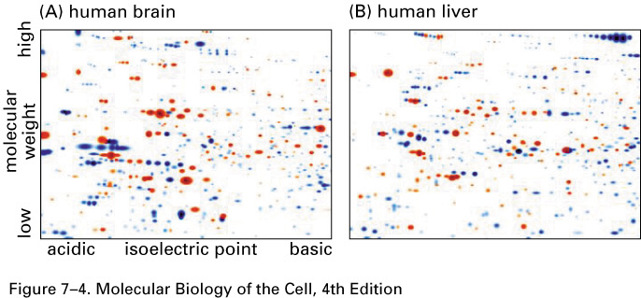
Differences in the proteins expressed by two human tissues.
In each panel, the proteins have been displayed using two-dimensional polyacrylamide gel electrophoresis.

Slide 8
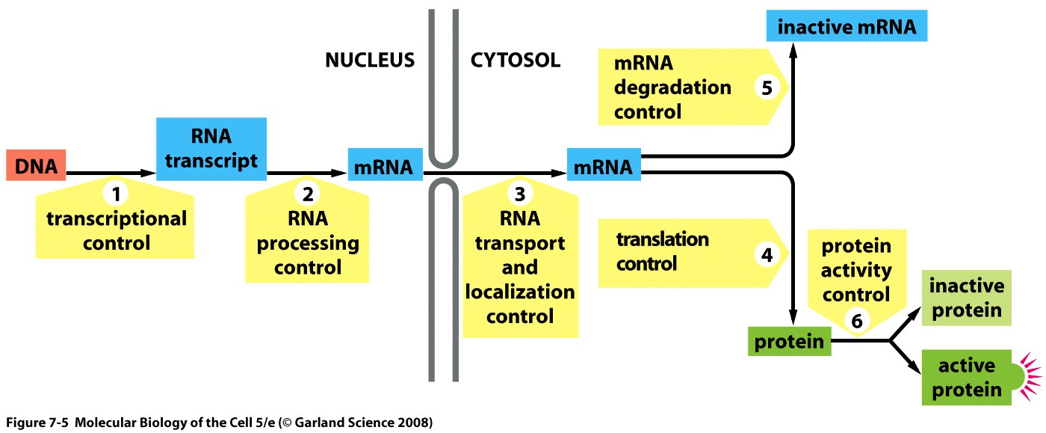
External signals can cause a cell to change the expression of its genes
Gene expression can be regulated at many steps
Six steps at which eukaryotic gene expression can be controlled.

Slide 9
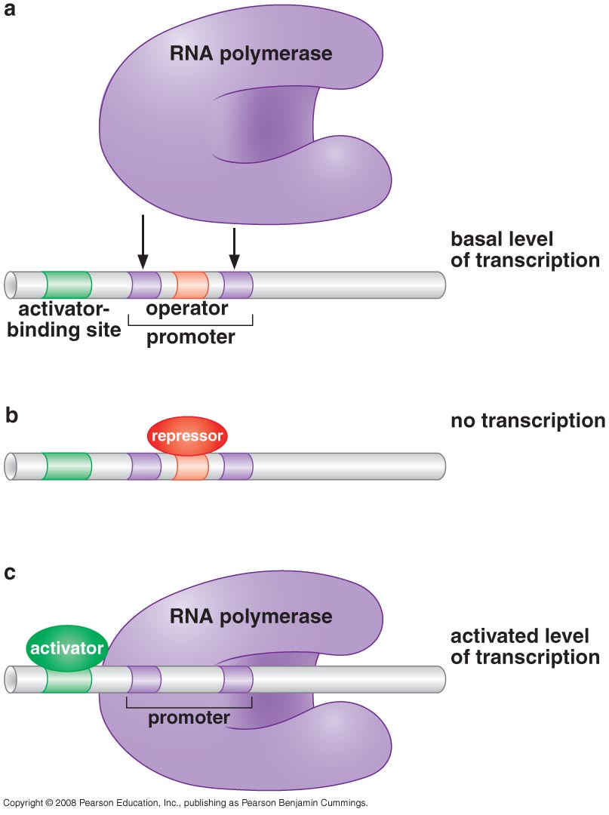
Transcription regulation in prokaryotes
PRINCIPLES OF TRANSCRITION REGULATION
Gene expression is controlled by regulatory proteins
(Activators and repressors act the level of transcription initiation)

Slide 10
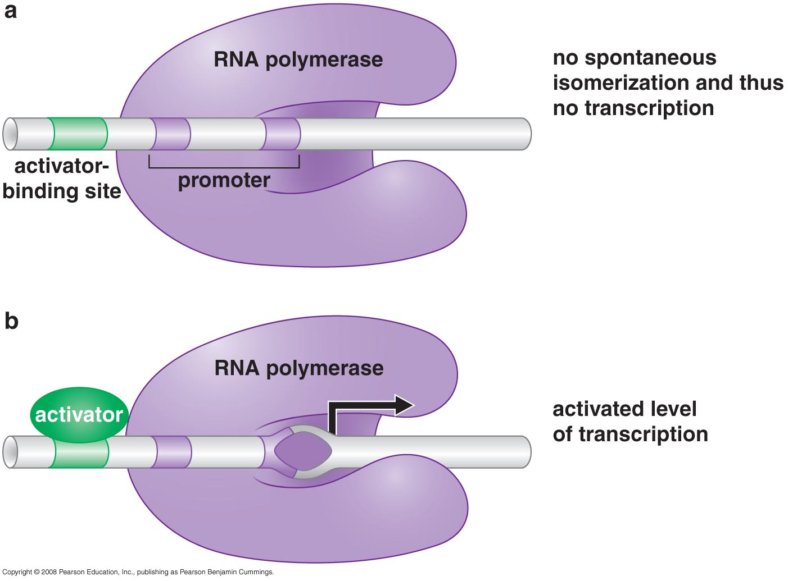
Allosteric activation of RNA polymerase

Slide 11
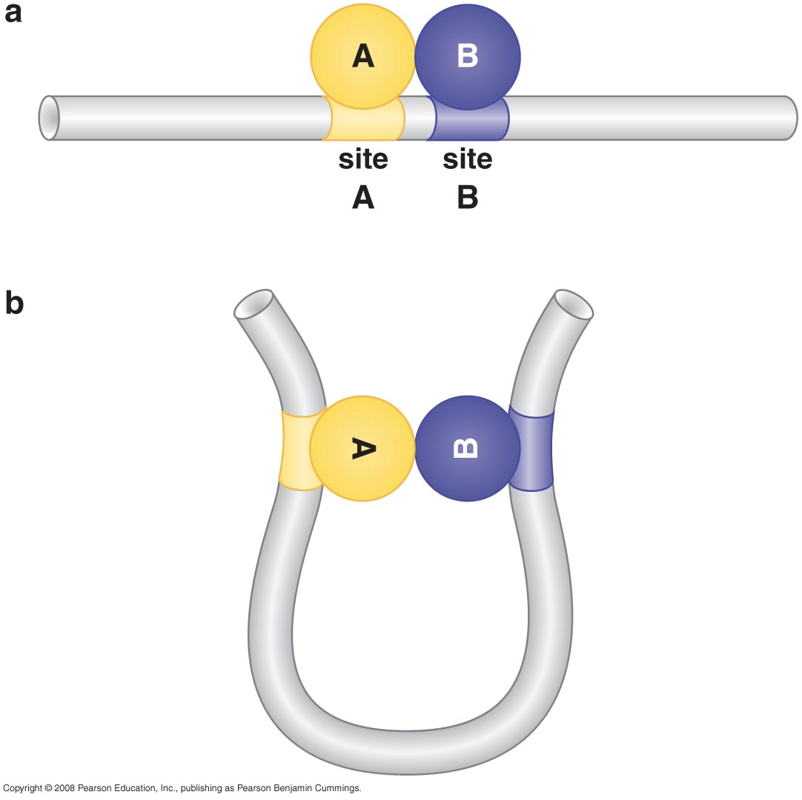
Action at a distance and DNA looping

Slide 12
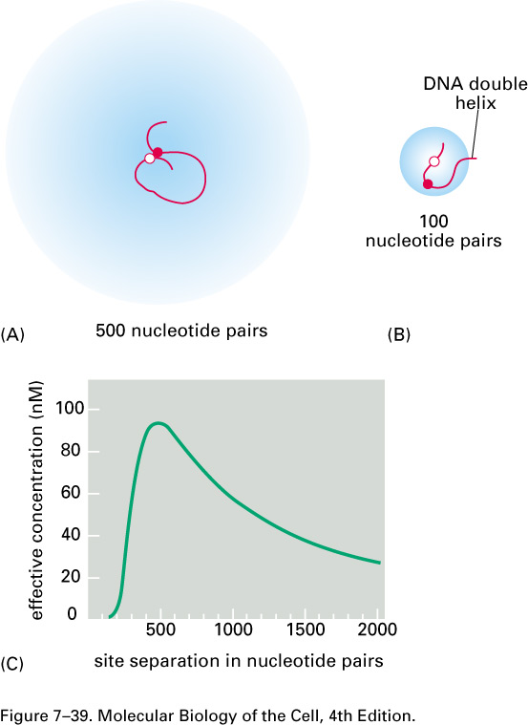
Binding of two proteins to separate sites on the DNA double helix can greatly increase their probability of interacting.
(A) The tethering of one protein to the other via an intervening DNA loop of 500 nucleotide pairs increases their frequency of collision. The intensity of blue coloring reflects the probability that the red protein will be located at each position in space relative to the white protein. (B) The flexibility of DNA is such that an average sequence makes a smoothly graded 90° bend (a curved turn) about once every 200 nucleotide pairs. Thus, when two proteins are tethered by only 100 nucleotide pairs, their contact is relatively restricted. In such cases the protein interaction is facilitated when the two protein-binding sites are separated by a multiple of about 10 nucleotide pairs, which places both proteins on the same side of the DNA helix (which has about 10 nucleotides per turn) and thus on the inside of the DNA loop, where they can best reach each other. (C) The theoretical effective concentration of the red protein at the site where the white protein is bound, as a function of their separation

Slide 13
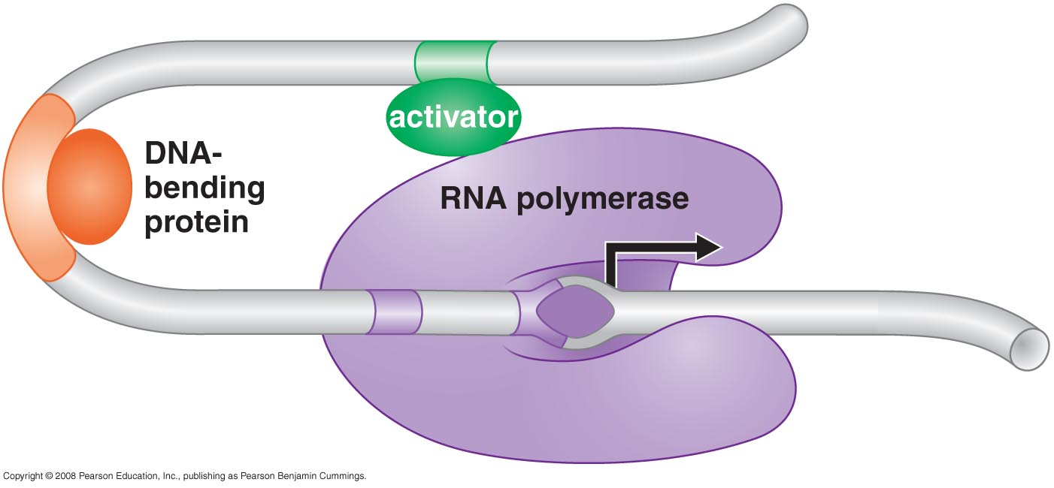
A DNA-bending protein can facilitate interaction between distantly bound DNA-binding proteins

Slide 14
REGULATION OF TRANSCRIPTION INITIATION (Prokaryotes)
The Lac operon

Slide 15
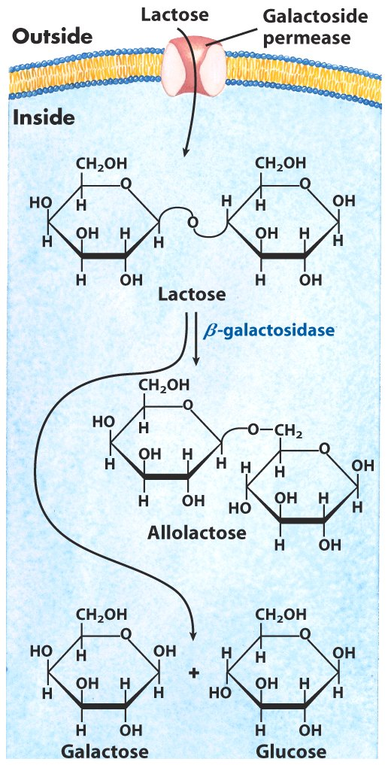
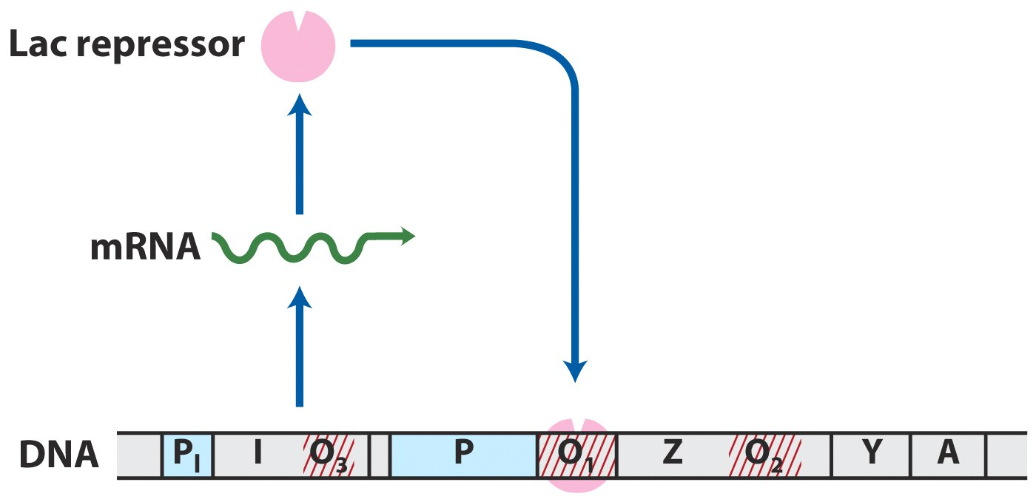
A transcriptional activator and a repressor control the Lac Operon
Lactose metabolism in E. coli

Slide 16
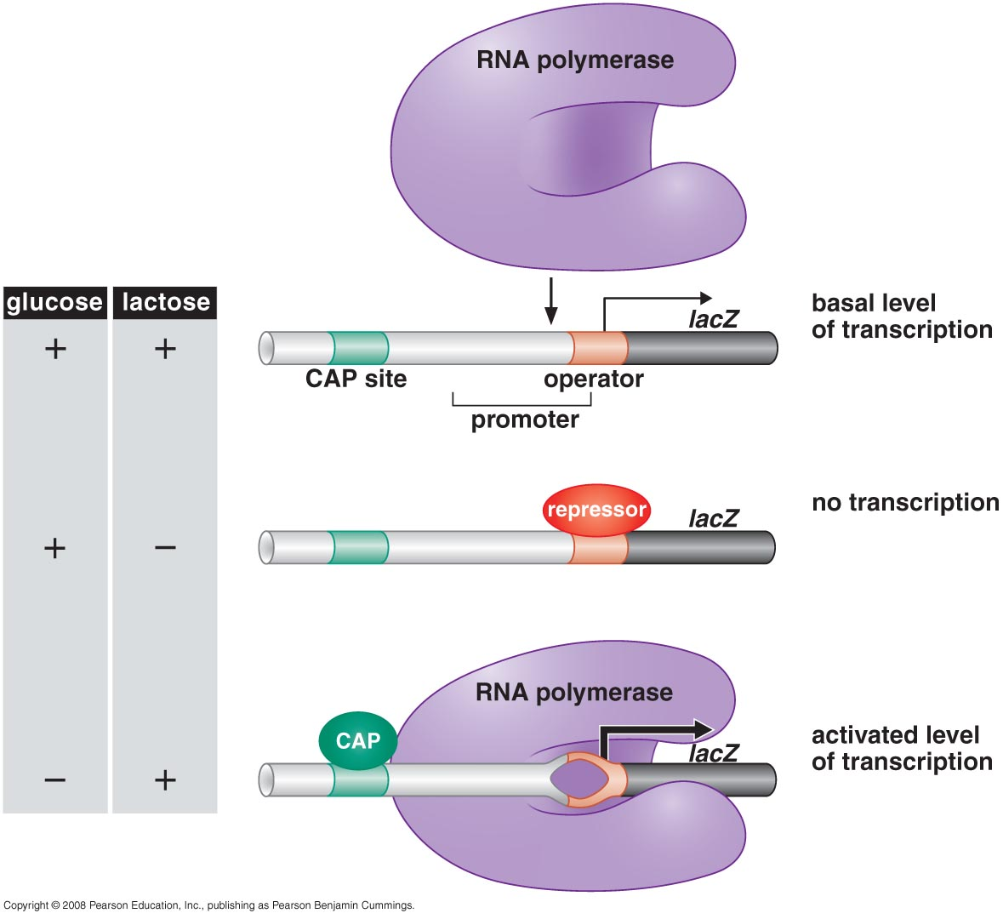
CAP and Lac repressor have opposing effects on RNAP binding to the lac promoter

Slide 17
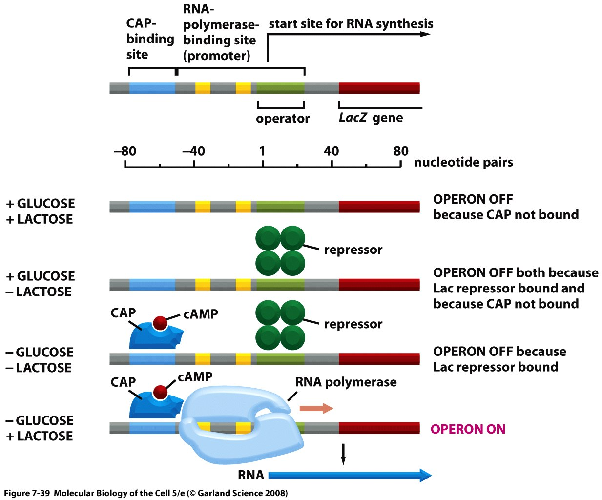
Dual control of the lacoperon. Glucose and lactose levels control the initiation of transcription of the lac operon through their effects on the lac repressor protein and CAP. Lactose addition increases the concentration of allolactose, which binds to the repressor protein and removes it from the DNA. Glucose addition decreases the concentration of cyclic AMP; because cyclic AMP no longer binds to CAP, this gene activator protein dissociates from the DNA, turning off the operon. As shown in Figure 7–11, CAP is known to induce a bend in the DNA when it binds; for simplicity, the bend is not shown here. LacZ, the first gene of the lac operon, encodes the enzyme β-galactosidase, which breaks down the disaccharide lactose to galactose and glucose
(Lactose remove repressor: Glu remove CAP)

Slide 18
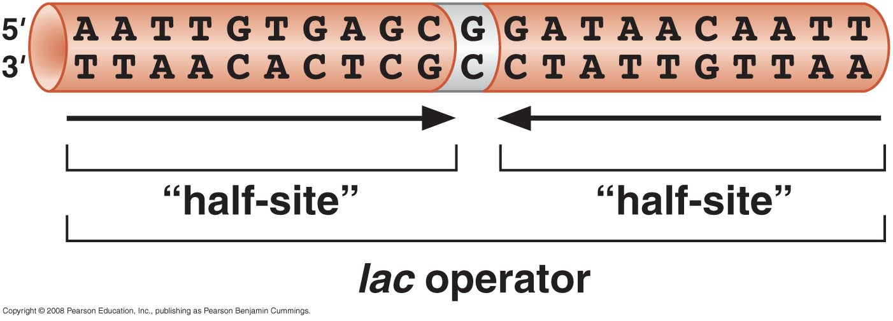
The symmetric half-sites of the lac operator

Slide 19
The control region of the lac operon

Slide 20
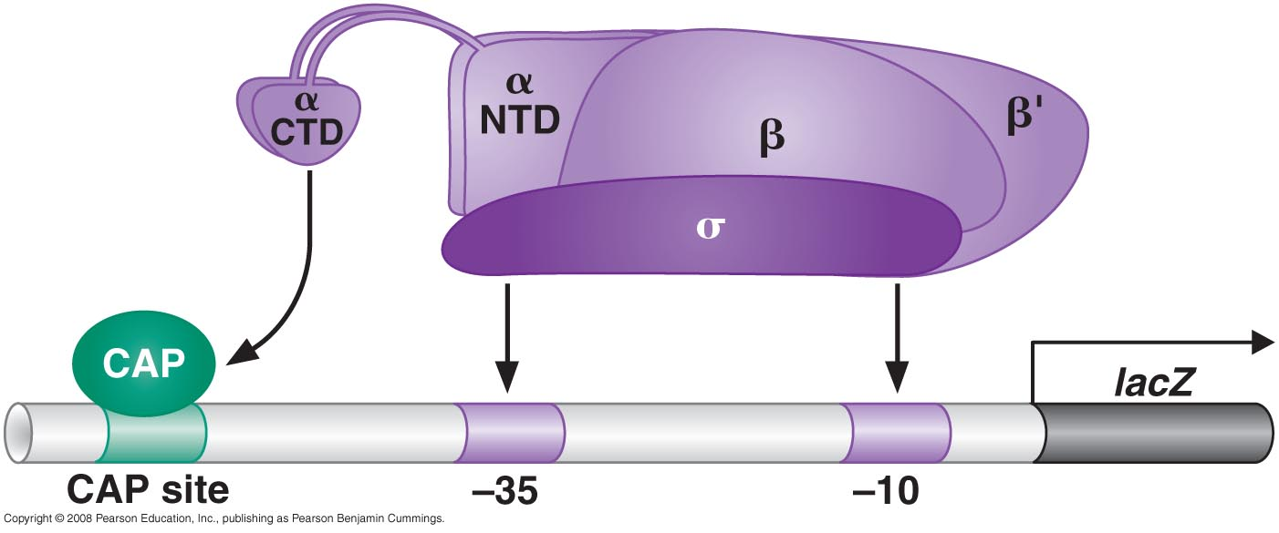
CAP has separate activating and DNA-binding surfaces

Slide 21
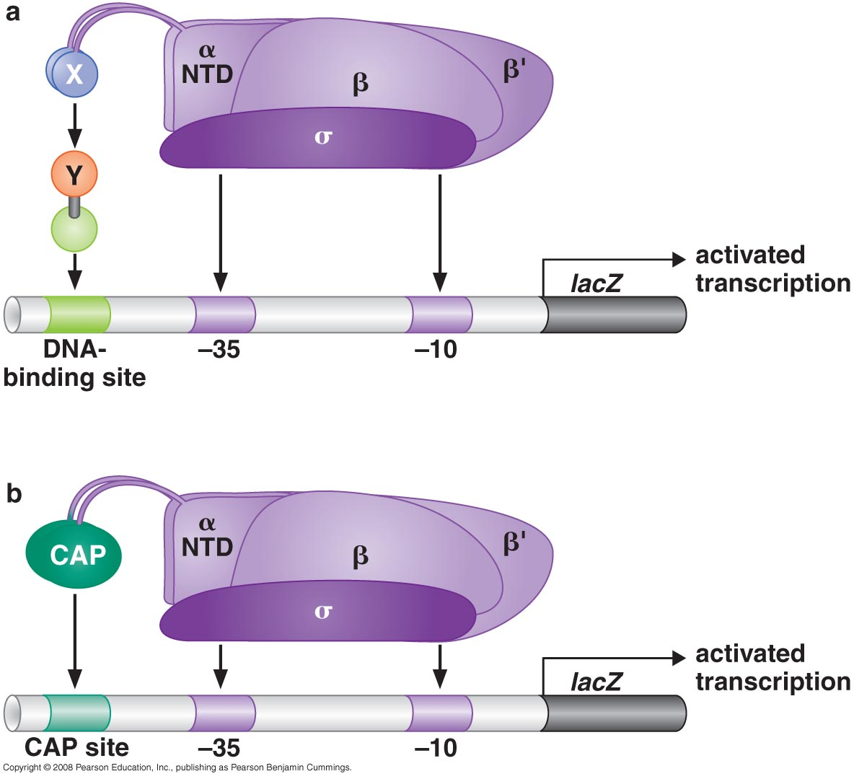
Activator bypass experiments

Slide 22
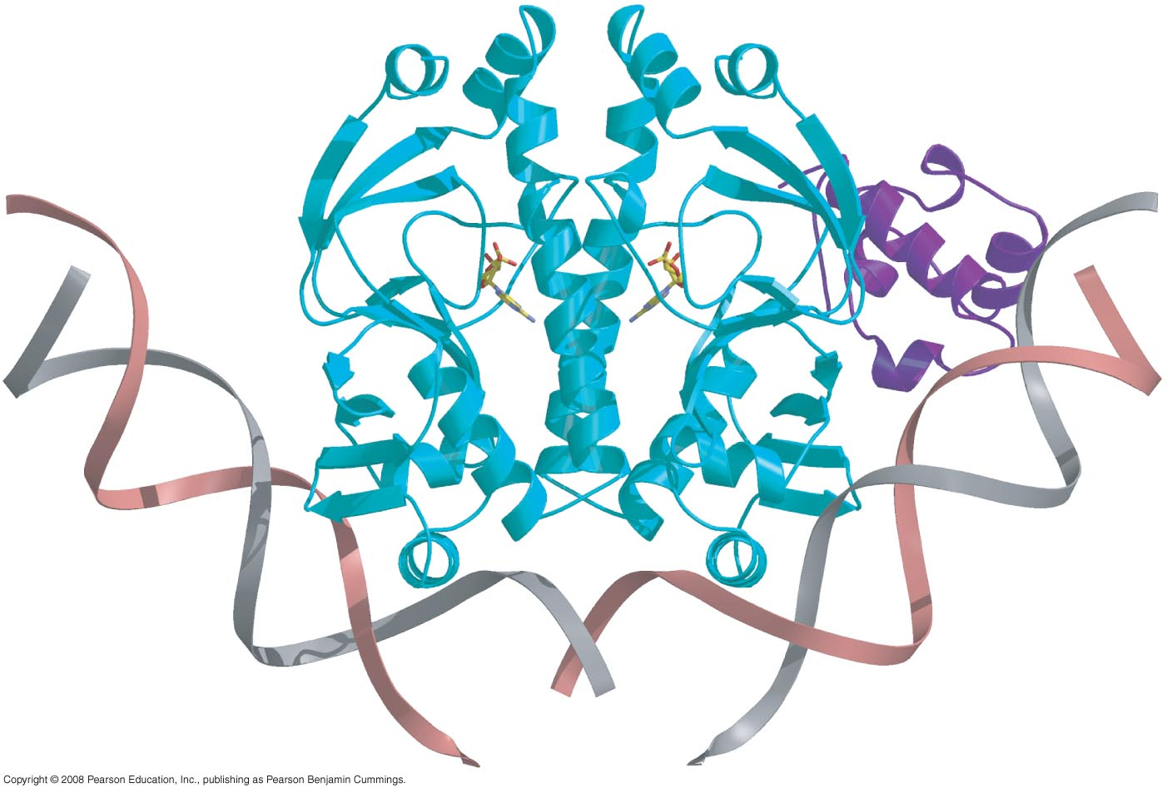
CAP and Lac repressor bind DNA using a common structural motif

Slide 23
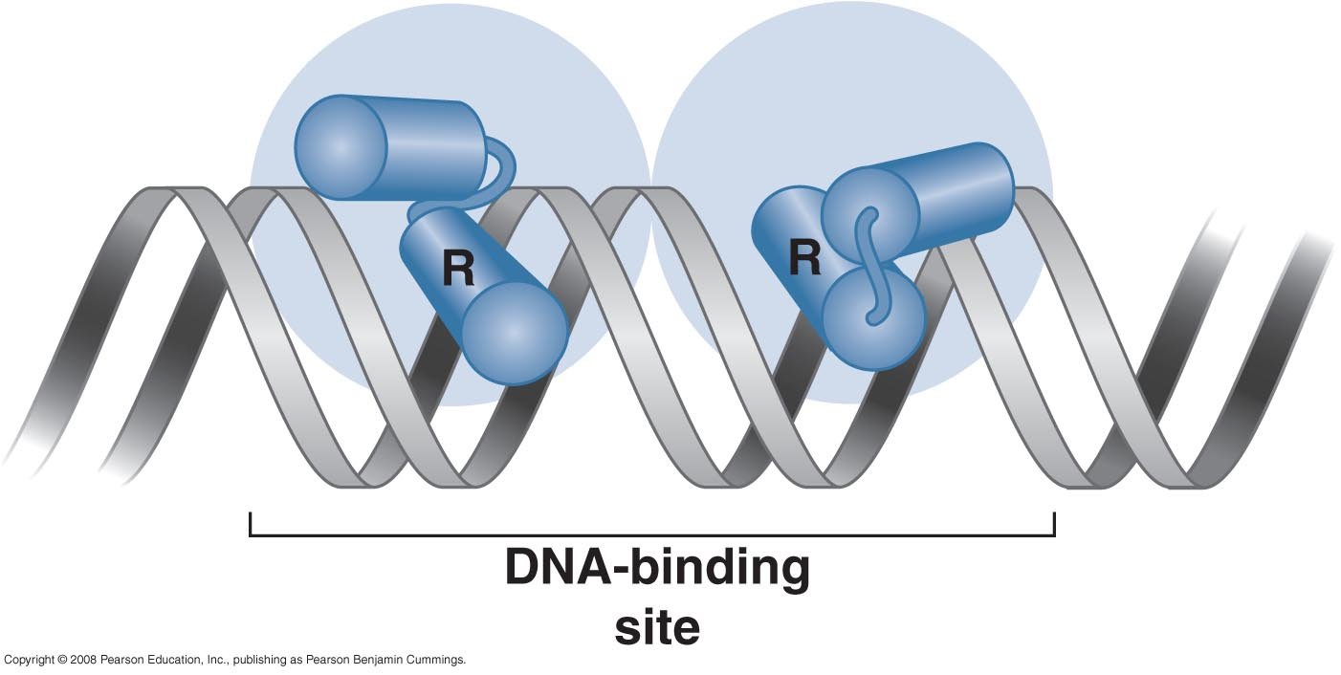
Binding of a protein with a helix-turn helix domain to DNA

Slide 24
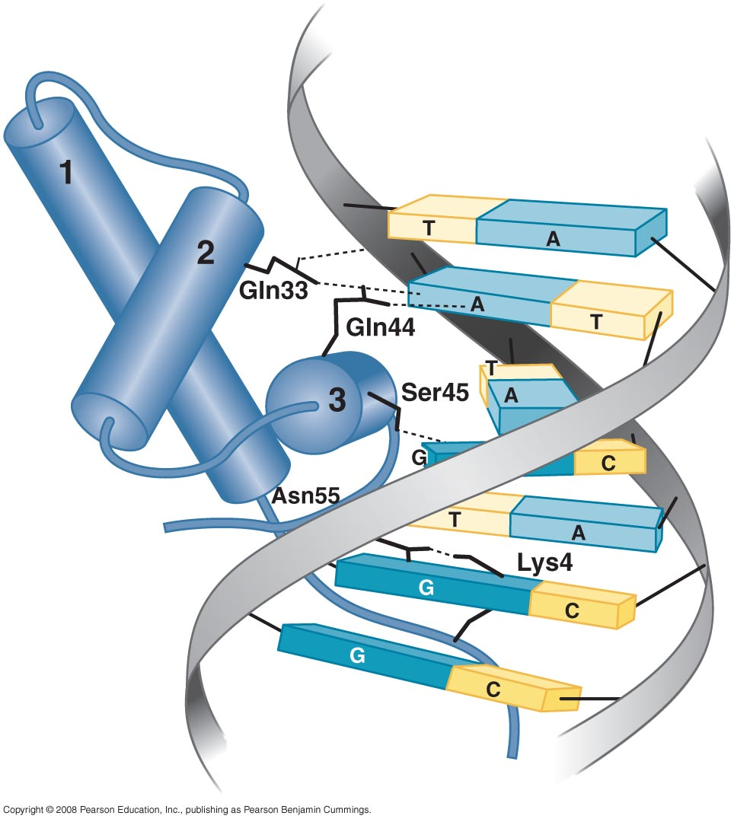
Hydrogen bonds between λ repressor and base pairs in the major groove of its operator

Slide 25
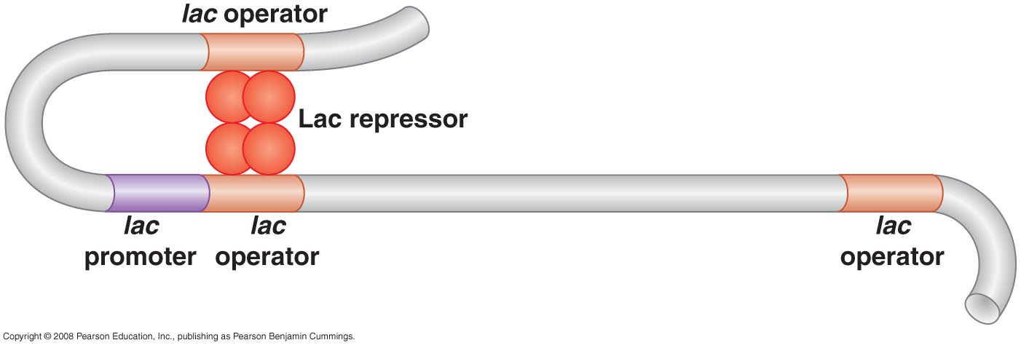
Lac repressor binds as a tetramer to two operators

Slide 26
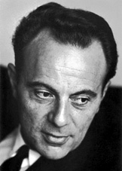
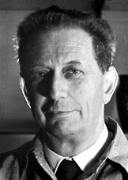
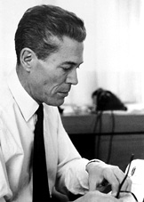
The Nobel Prize in Physiology or Medicine 1965
"for their discoveries concerning genetic control of enzyme and virus synthesis
François Jacob | André Lwoff | Jacques Monod
1/3 of the prize | 1/3 of the prize | 1/3 of the prize
France | France | France
Institut Pasteur Paris, France | Institut Pasteur Paris, France | Institut Pasteur Paris, France
b. 1920 | b. 1902 d. 1994 | b. 1910 d. 1976

Slide 27
Bacteria use interchangeable RNA polymerase subunits to help regulate gene transcription

Slide 28
Alternative σ factor direct RNA polymerase to alternative sets of promoters

Slide 29
NtrC and MerR: Transcriptional activators that work by allostery rather than by recruitment
NtrC has ATPase activity and works from DNA Sites far from the gene

Slide 30
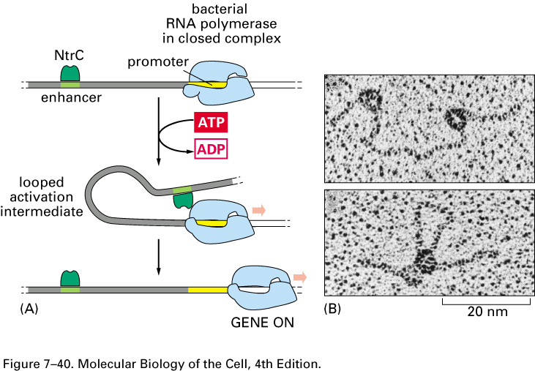
Gene activation at a distance. (A) NtrC is a bacterial gene regulatory protein that activates transcription by facilitating the transition between the initial binding of RNA polymerase to the promoter and the formation of an initiating complex. As indicated, the transition stimulated by NtrC requires the energy produced by ATP hydrolysis, although this requirement is unusual for bacterial transcription initiation. (B) The interaction of NtrC and RNA polymerase, with the intervening DNA looped out, can be seen in the electron microscope. Although transcriptional activation by DNA looping is unusual in bacteria, it is typical of eucaryotic gene regulatory proteins.

Slide 31
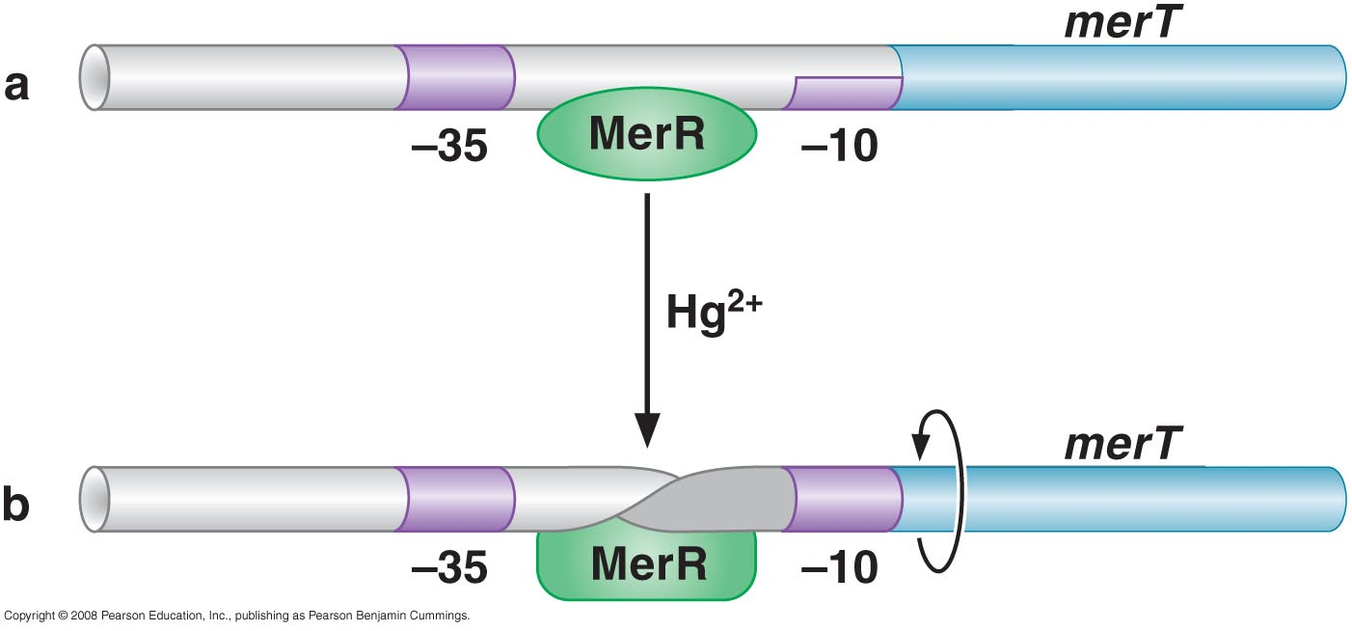
MerR activates transcription by twisting promoter DNA

Slide 32
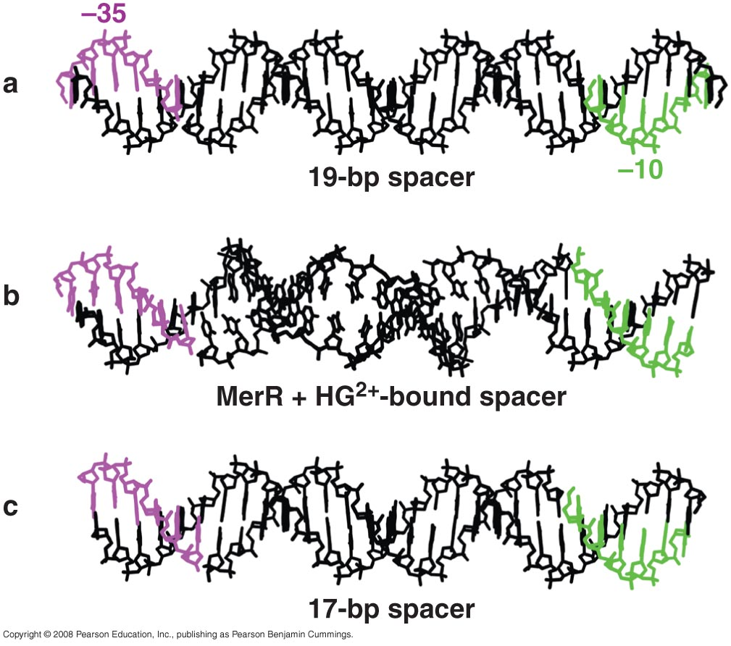
Structure of a merT-like promoter

Slide 33
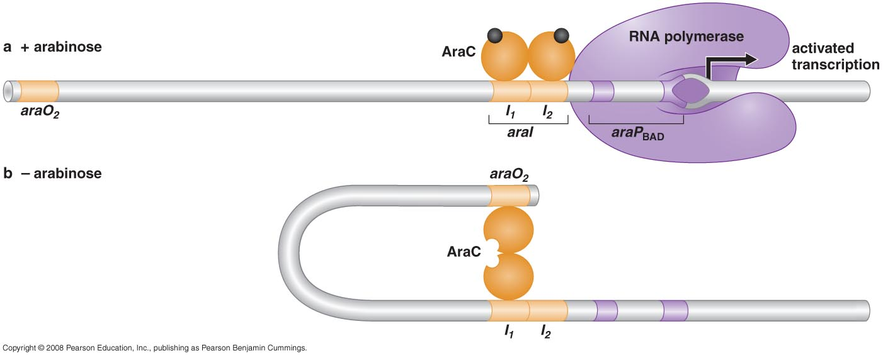
Some repressors hold RNA polymerase at the promoter rather than excluding it
AraC and control of the araBAD operon by antiactivation

Slide 34
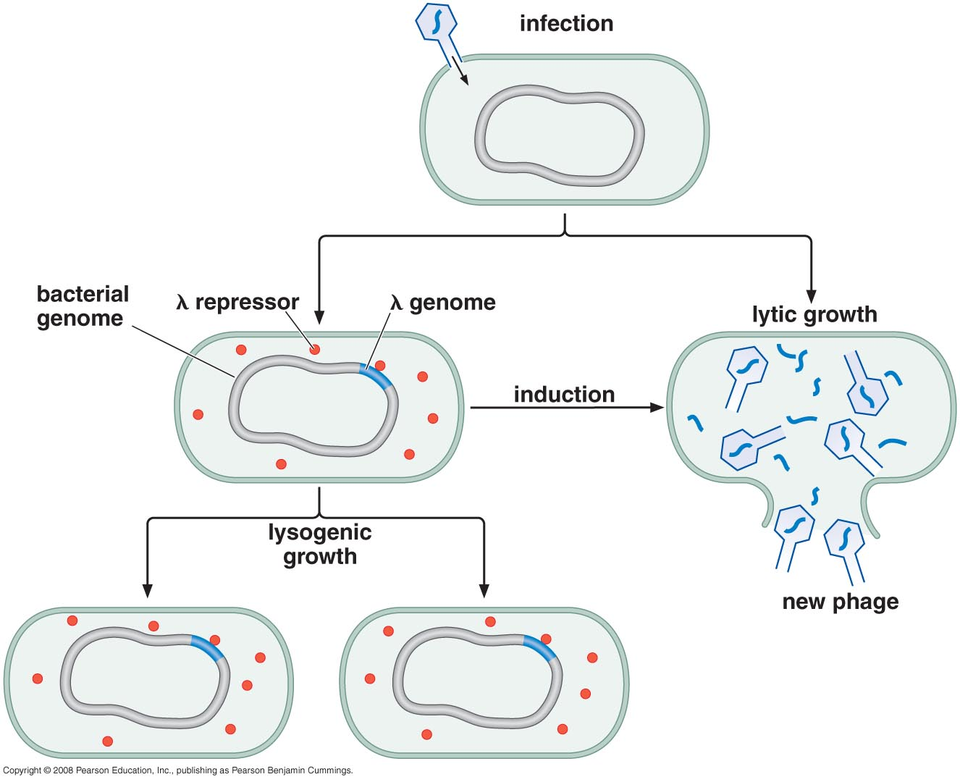
THE CASE OF BACTERIOPHAGE λ: layers of regulation

Slide 35
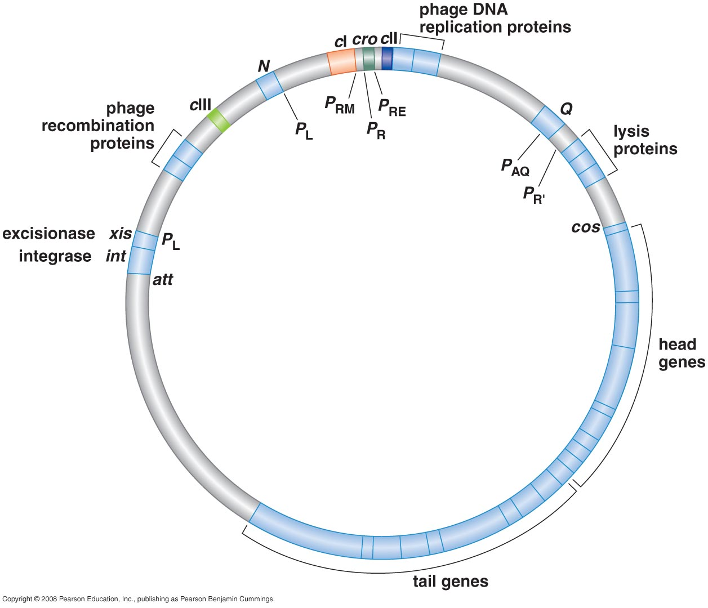
Alternative patterns of gene expression control lytic and lysogenic growth
Map of bacteriophage λ

Slide 36
Promoters in the control regions of bacteriophage λ

Slide 37
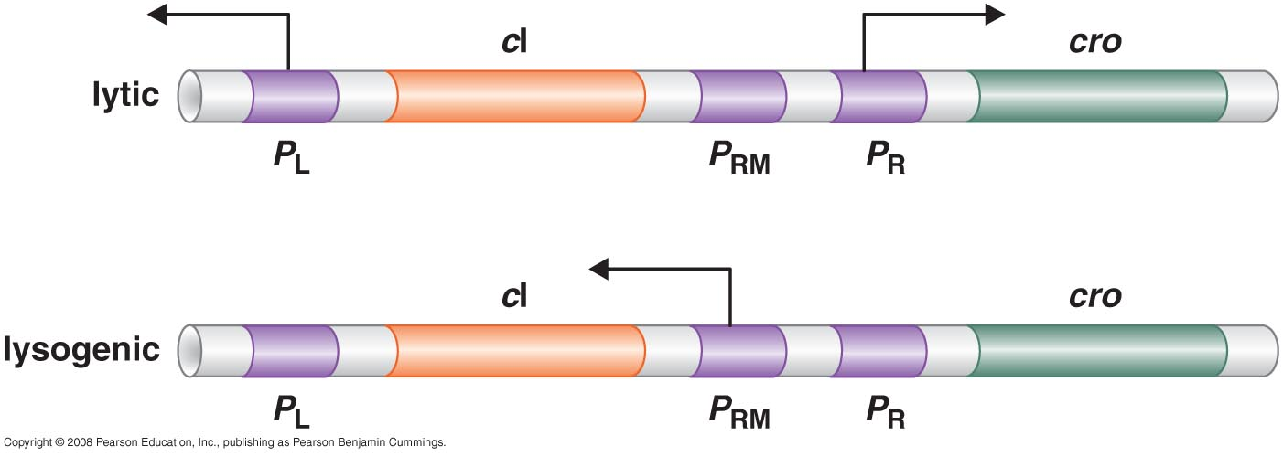
Transcription in the λ control regions in lytic & lysogenic growth

Slide 38
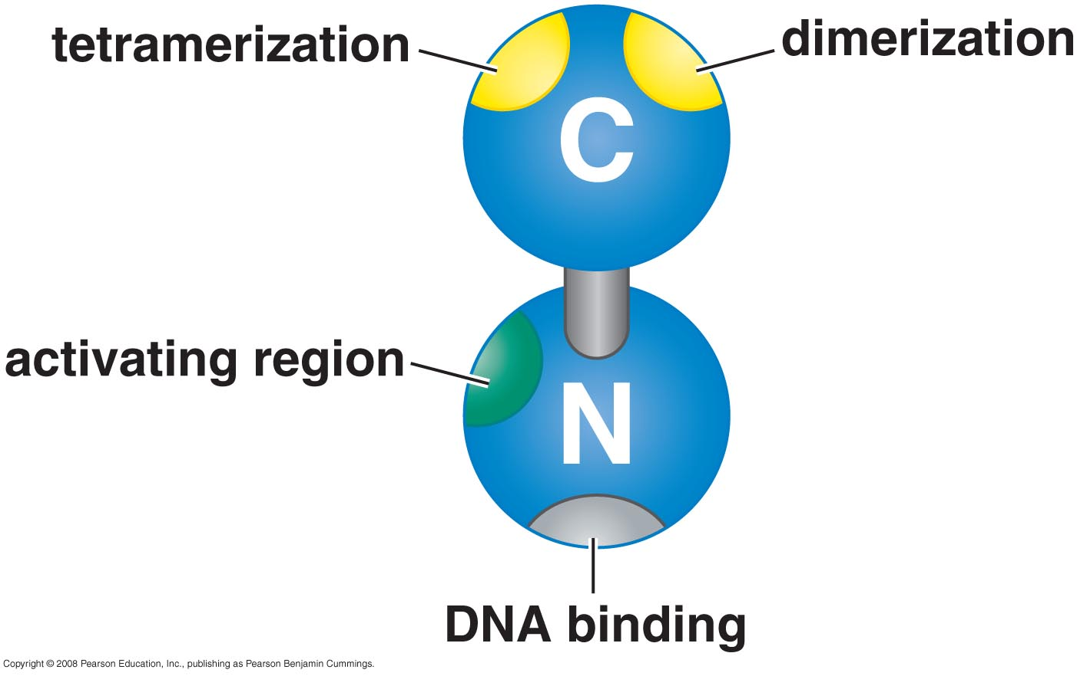
Regulatory proteins and their binding sites

Slide 39
Relative positions of promoter and operator sites of λ control region
Repressor bound at OR2 can activate PRM and repress PR

Slide 40
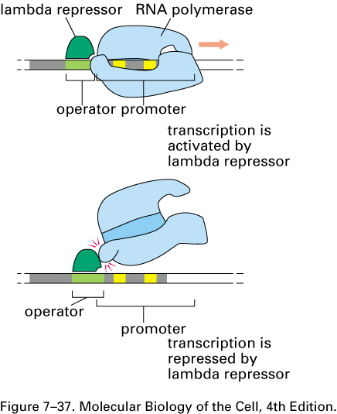
Some bacterial gene regulatory proteins can act as both a transcriptional activator and a repressor, depending on the precise placement of its binding sites in DNA.
An example is the bacteriophage lambda repressor. For some genes, the protein acts as a transcriptional activator by providing a favorable contact for RNA polymerase (top). At other genes (bottom), the operator is located one base pair closer to the promoter, and, instead of helping polymerase, the repressor now competes with it for binding to the DNA. The lambda repressor recognizes its operator by a helix–turn–helix motif, as shown in Figure 7–14.

Slide 41
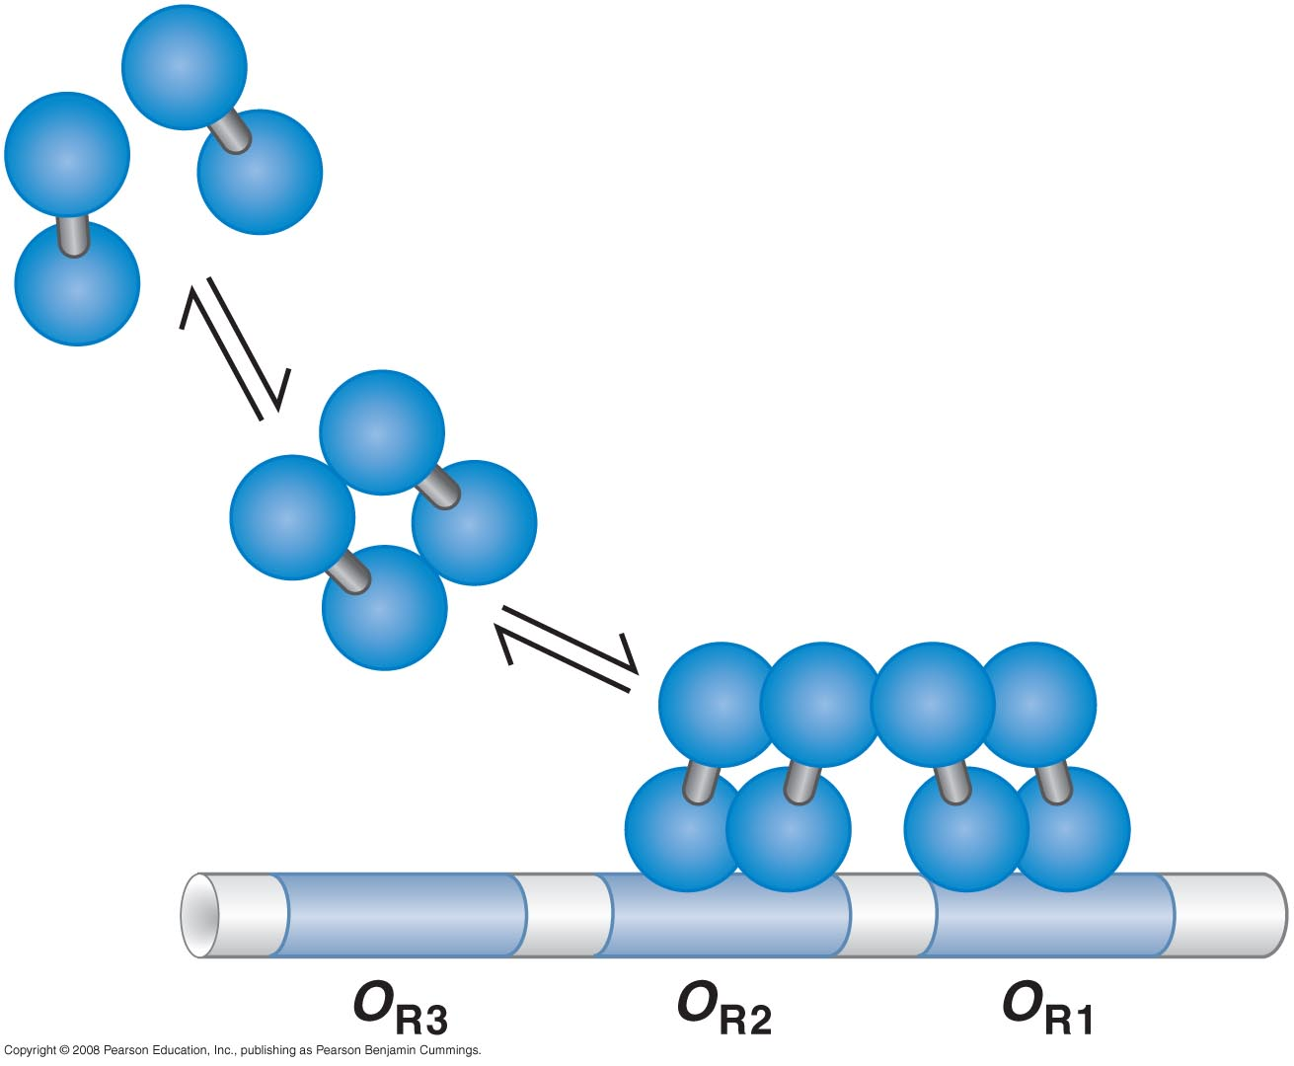
λ repressor binds to operator sites cooperatively

Slide 42
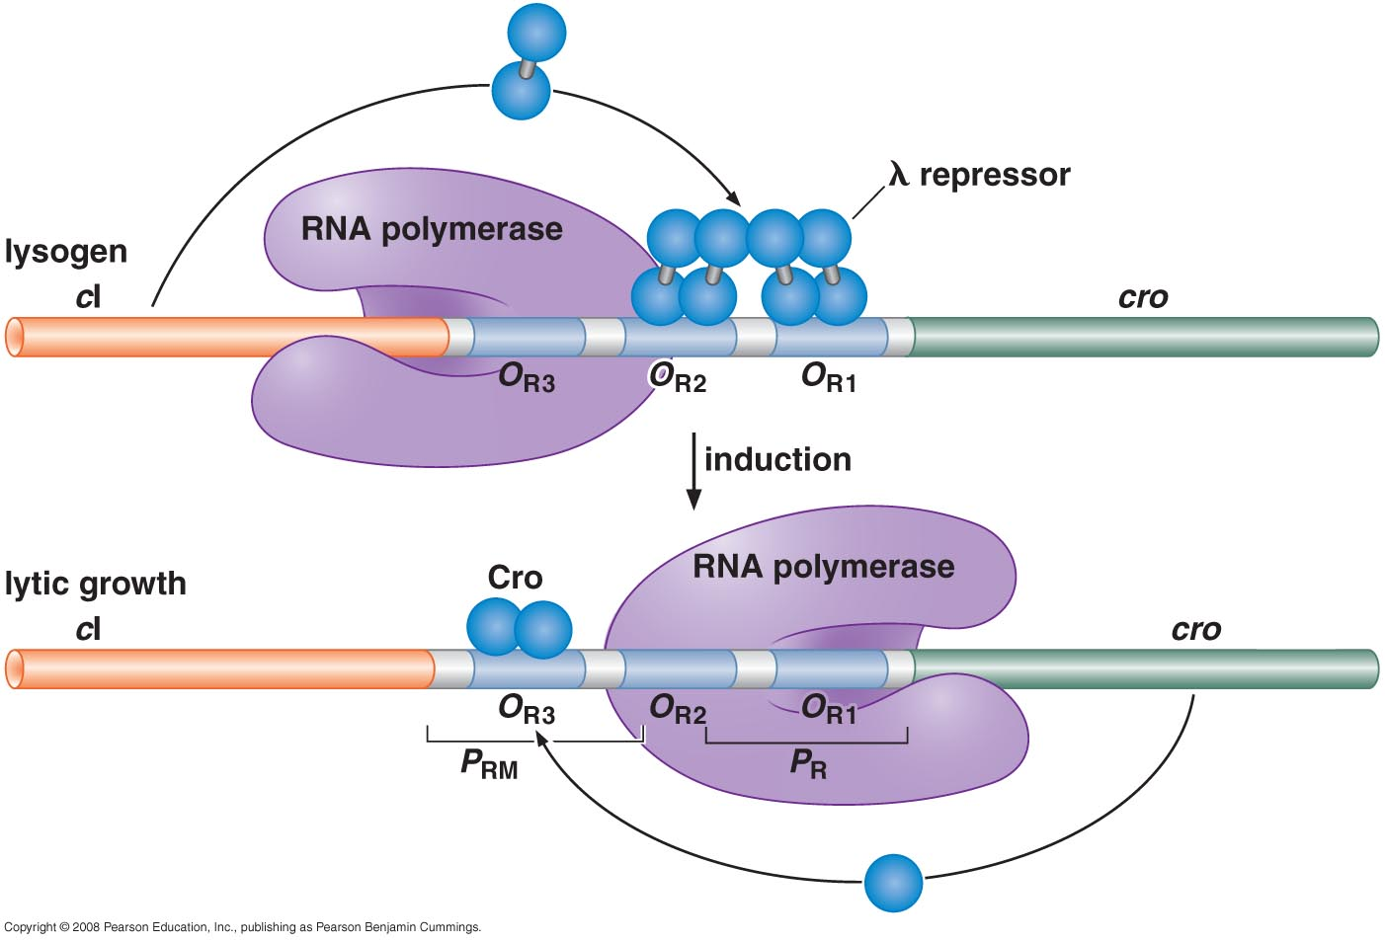
Repressor and Cro bind in different patterns to control lytic and lysogenic growth

Slide 43
Lysogenic induction requires proteolytic cleavage of λ repressor
DNA damage→ RecA → autocleavage LexA → SOS → DNA Repair
DNA damage→ RecA → autocleavage l repressor → activation of PR & PL → Lysogenic to lytic growth

Slide 44
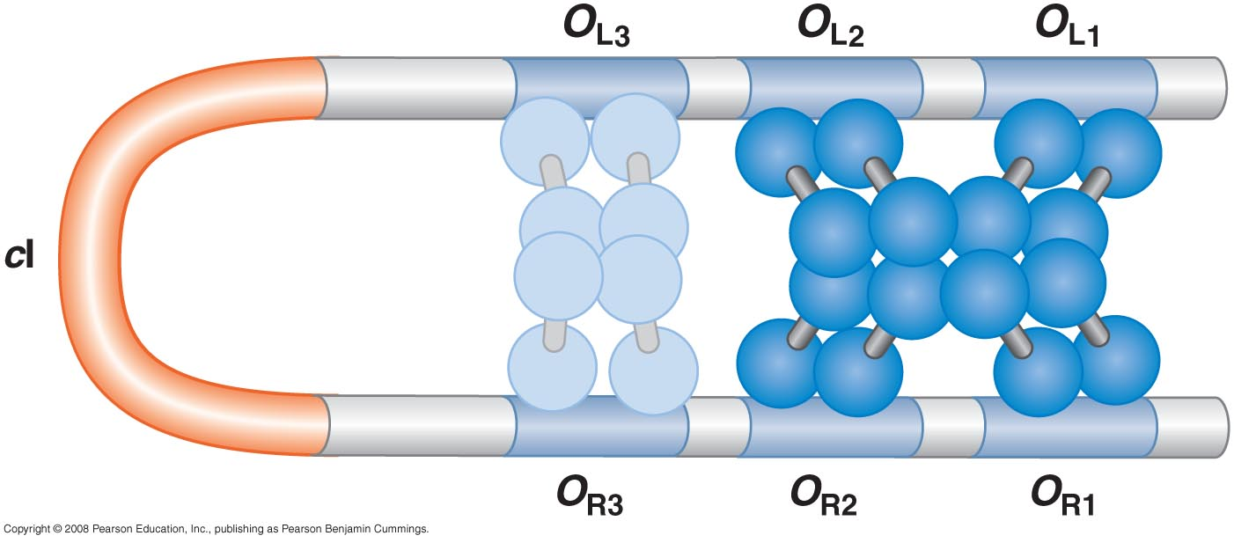
Negative auto regulation of repressor requires long-distance interactions and large DNA loop

Slide 45
Another activator, λ CII, control the decision between lytic and lysogenic growth upon infection of a new host
(CII binds to PRE, a weak promoter, and also stimulates transcription of CI repressor.
Only when enough CI made from PRE can CI binds to OR1 and OR2 and direct it own synthesis from PRM)

Slide 46
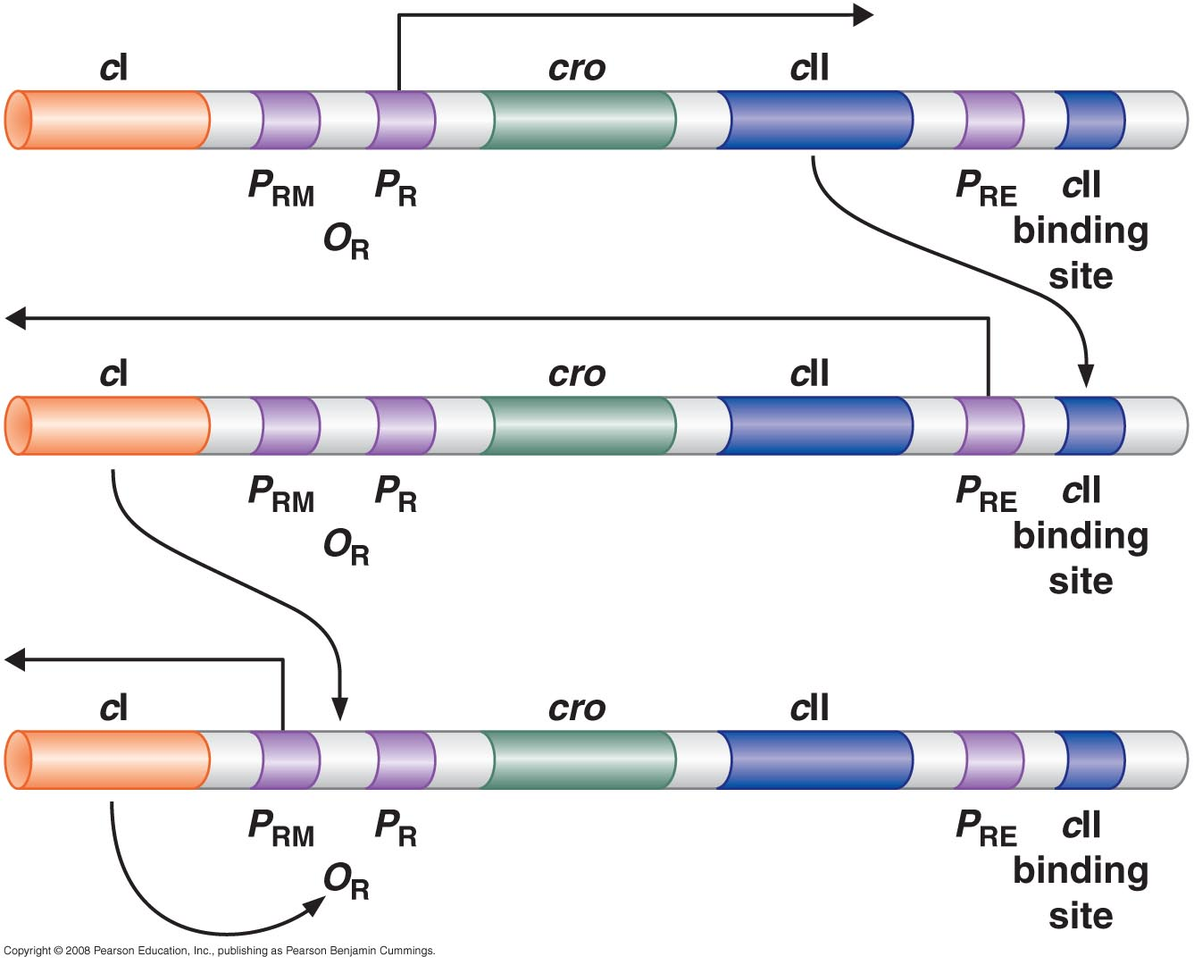
Establishment of lysogeny
Competition between Cro and CII

Slide 47
The number of phage particles infecting a given cell affects whether the infection proceeds lytically or lysogenically
Moi (multiplicity of infection) less than 1 -> lysis
Moi more than 2 -> lysogeny

Slide 48
Growth conditions of E. coli control the stability of CII protein and thus the lytic/lysogenic choice
Growth condition good for host cells -> FtsH very active ->
CII destroyed -> CI (repressor) not made -> Lytic

Slide 49
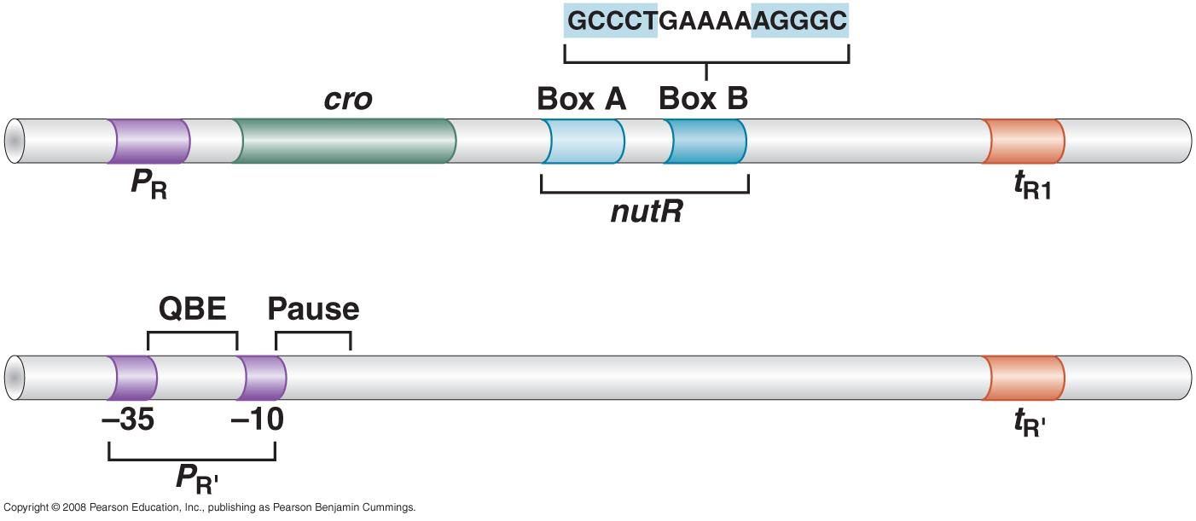
Transcriptional antitermination in λ development
(transcriptional regulation after initiation)
Transcription would terminate shortly after RNAP leave promoter unless RNA polymerase has been modified by λ Q and N proteins, thus Q & N are called anti-terminators
N recognize Sequence RNA
Q recognize Sequence DNA

Slide 50
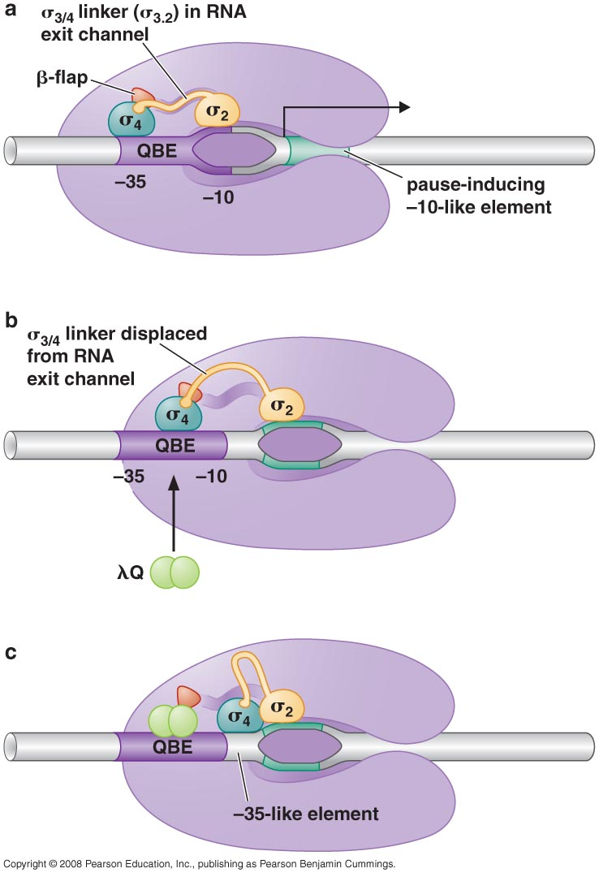
When Q is bound, the RNA polymerase is able to transcribe through the TR’

Slide 51
Retroregulation: An interplay of controls on RNA synthesis and stability determines Int (integrase) gene expression
(CII binds to PI’ directly stimulate transcription of Int; But without CII, transcription initiated by PL would also transcrip Int, but is destroyed nuclease).

Slide 52
+ CII -> CI & Int from PI -> lysogenic
CII -> PL on -> Int from PL
How to prevent this?

Slide 53
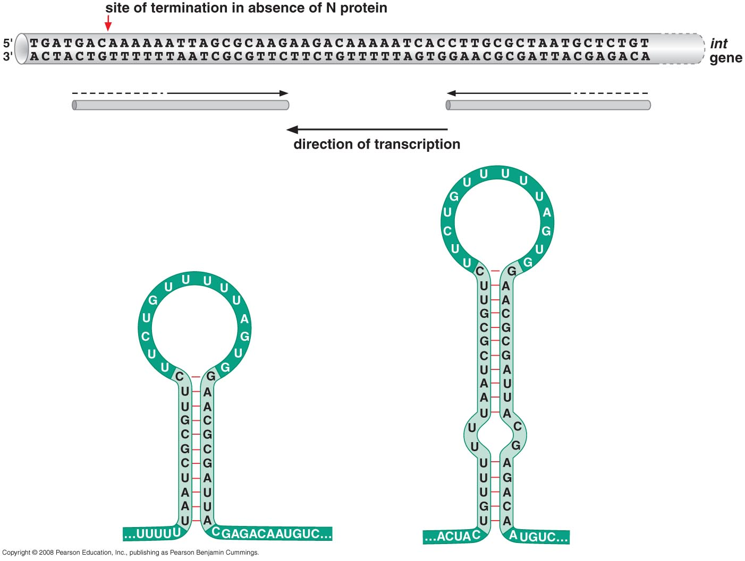
Left mRNA made from PI stop at the site indicated by the red arrow, RNA made from PL influenced by N protein go through and went beyond stop site can be degraded by nuclease (right)

Slide 54
